Slide 1
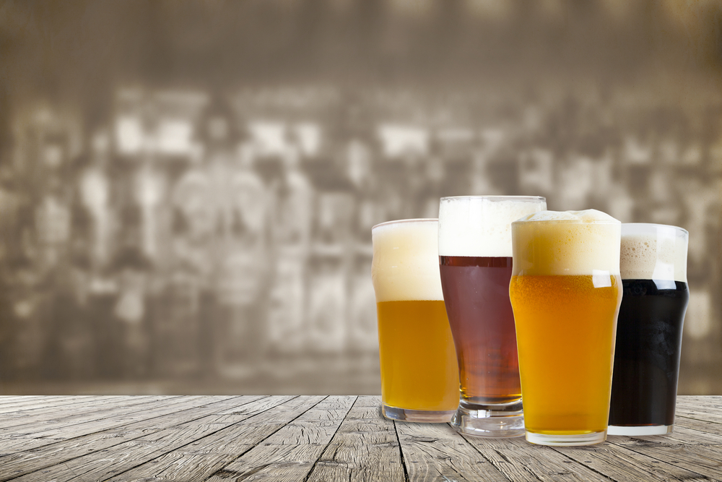
Craft Beer in the United States
Angie Hilliker
Bryan Wood
Stephen Walthall
Lauren Taylor
Notes:
Still a work in process! - BW
Anyone living in Richmond in the past eight years has probably noticed the ever-growing concentration of craft beer establishments. Standing in Scott’s Addition, you can hardly kick a beer can without hitting a brewery (I’ve seen this happen). Walk down the beer aisle in any supermarket, and you will probably notice a variety of craft beer from all over the country. The trend seems obvious, but we wondered: What does the data show?

Slide 2
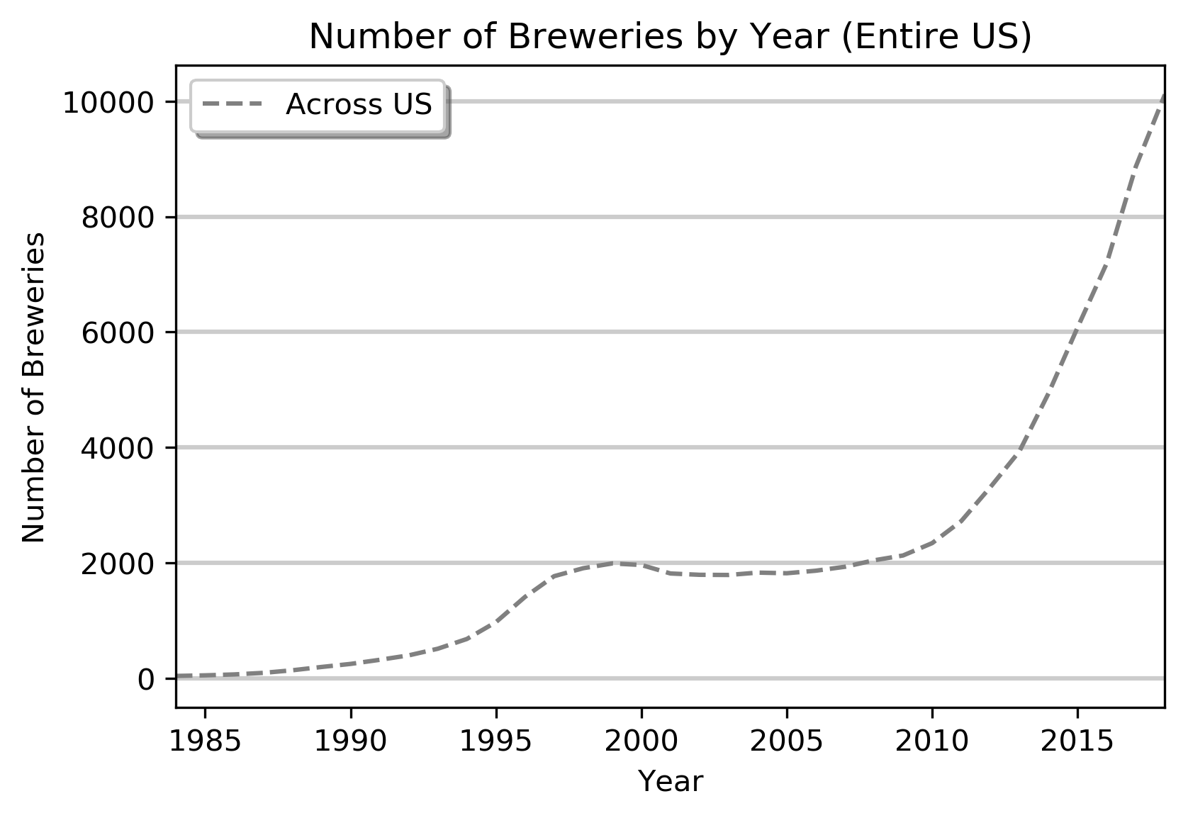
Growth in Number of Breweries in the US
(Alcohol and Tobacco Tax and Trade Bureau)
Notes:
Using federal data from the Alcohol and Tobacco Tax and Trade Bureau, we graphed the total # of breweries per year in the US (including DC, not territories) from 1984-2018.
Analysis: There was a rise in the late 90’s followed by closures and then the levels were steady for about 8 years.
We’ve seen a 400% increase in brewery number since 2000
How does this breakdown by region?

Slide 3
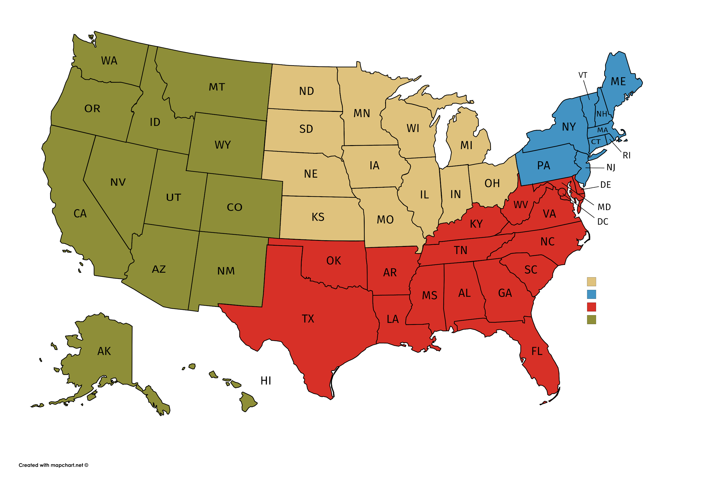
Growth in Number of Breweries by Region
(Alcohol and Tobacco Tax and Trade Bureau)
Notes:
States were grouped by region to make the analysis of 50 states easier by line chart.
Regions: Northeast, South, Midwest, west

Slide 4
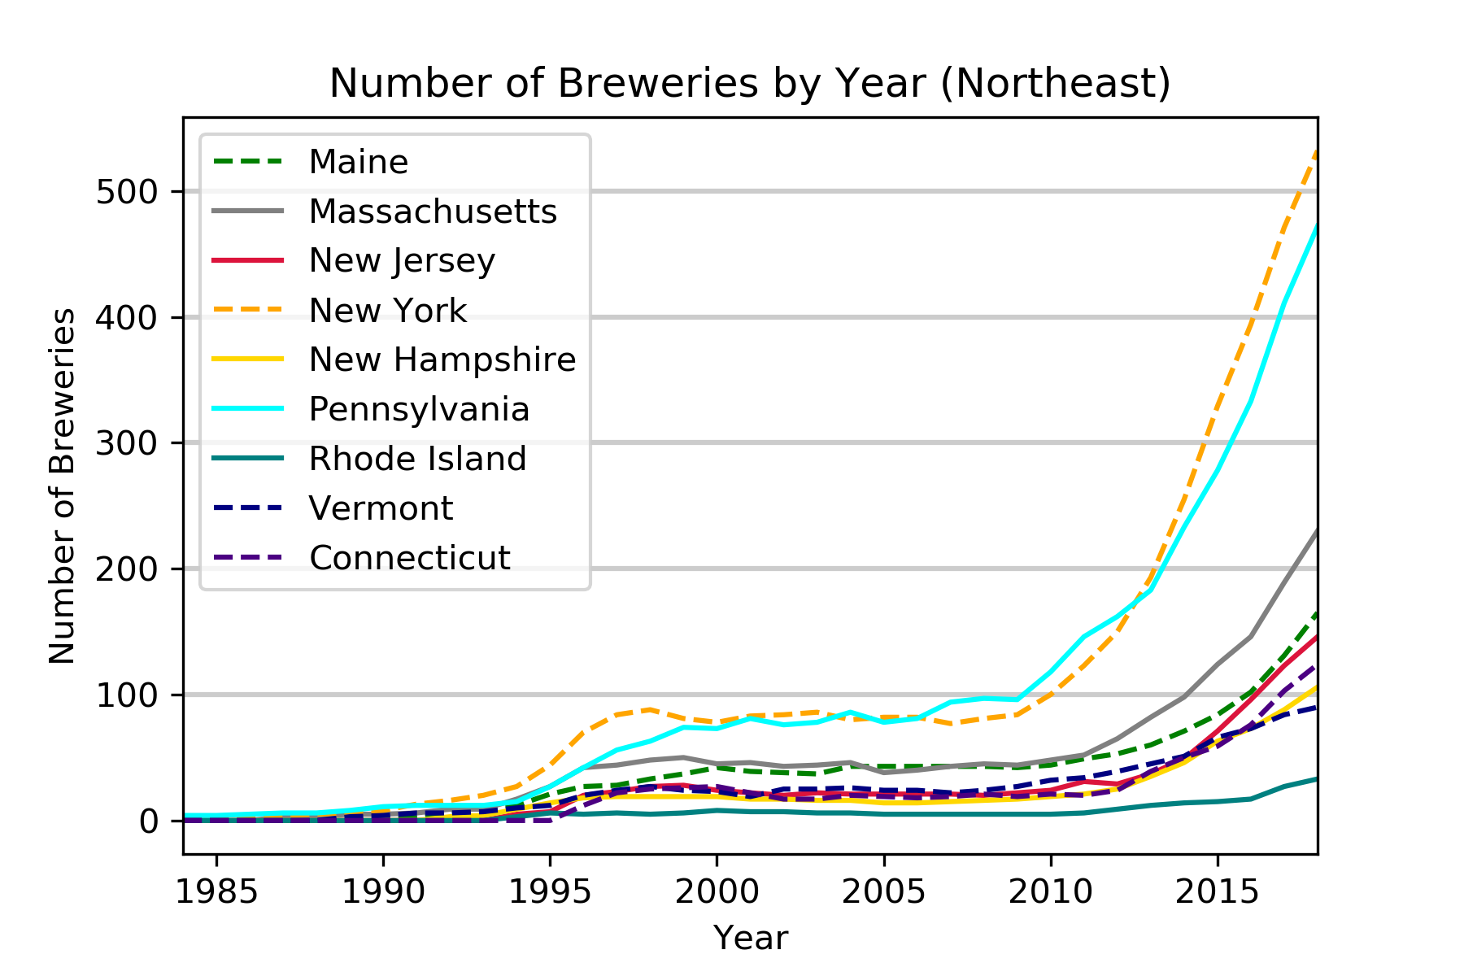
Growth in Number of Breweries by Region: NE
NE Leaders:
New York
Pennsylvania
(Alcohol and Tobacco Tax and Trade Bureau)
Notes:
Number of breweries per year from 1985-2018 for states in the NE
Analysis: point out the leaders… c’mon RI

Slide 5
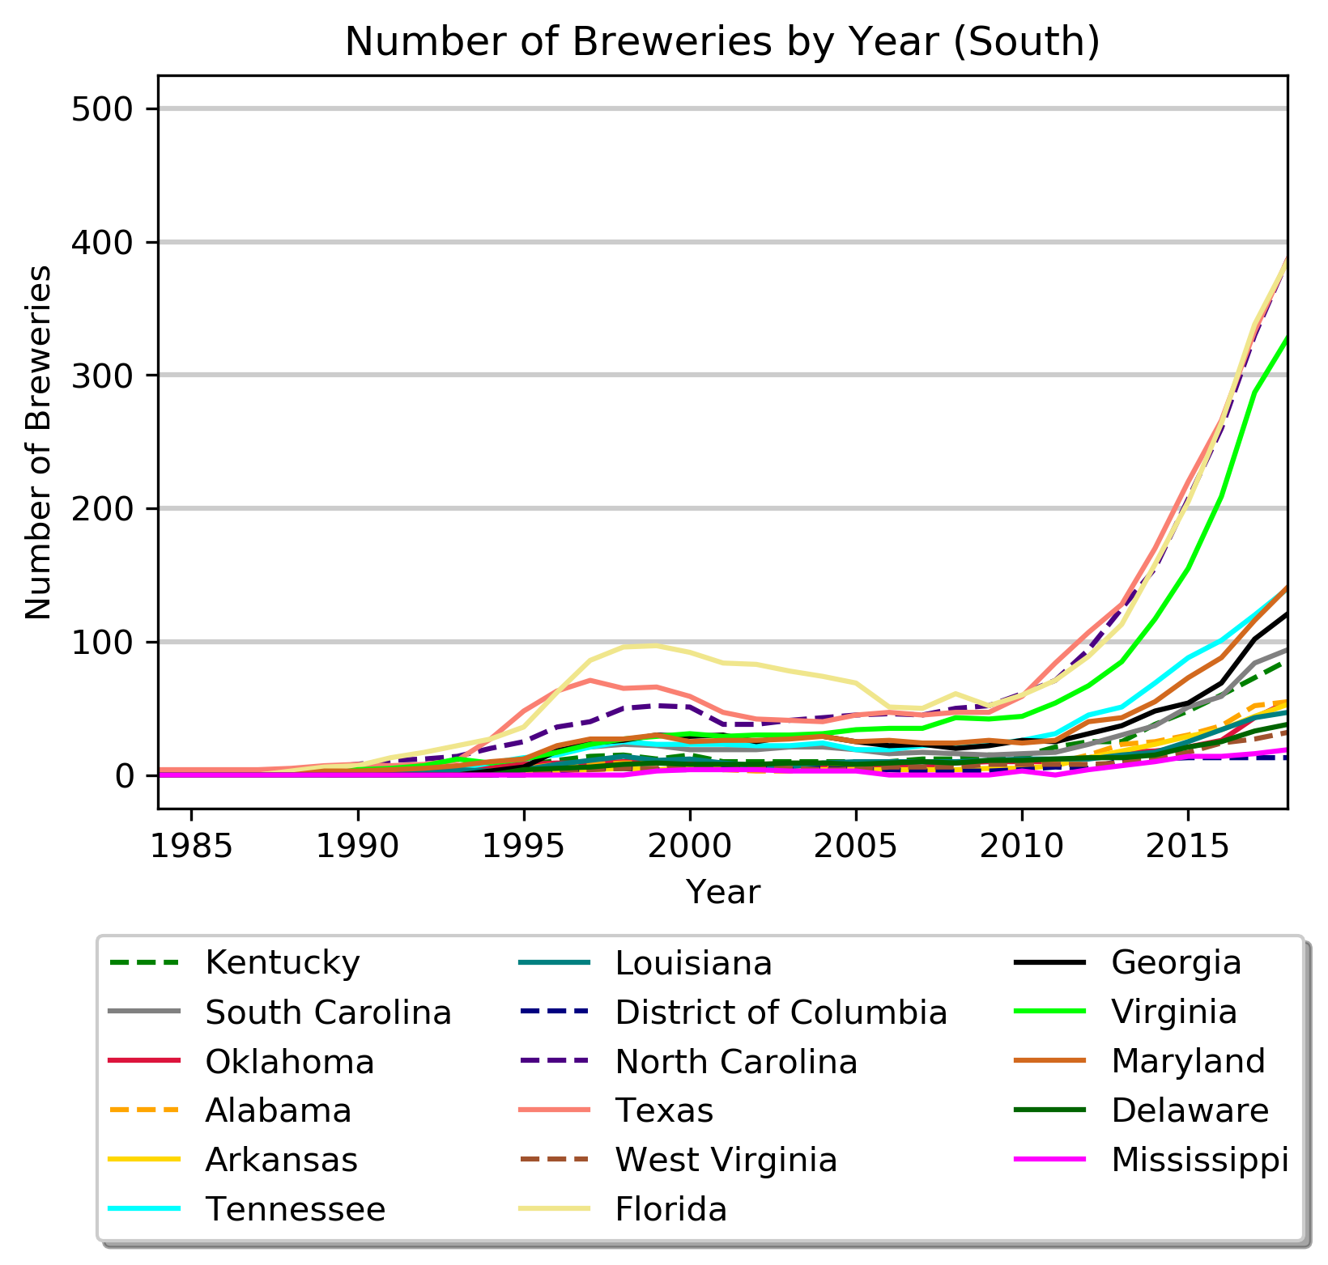
Growth in Number of Breweries by Region: South
Virginia
South Leaders:
Florida
Texas
North Carolina
(Alcohol and Tobacco Tax and Trade Bureau)
Notes:
Number of breweries per year from 1985-2018 for states in the South
Analysis: point out the leaders… long decline for brewing in FL from 1998 to 2006
This data breakdown allows us to see microtrends specific to certain states

Slide 6
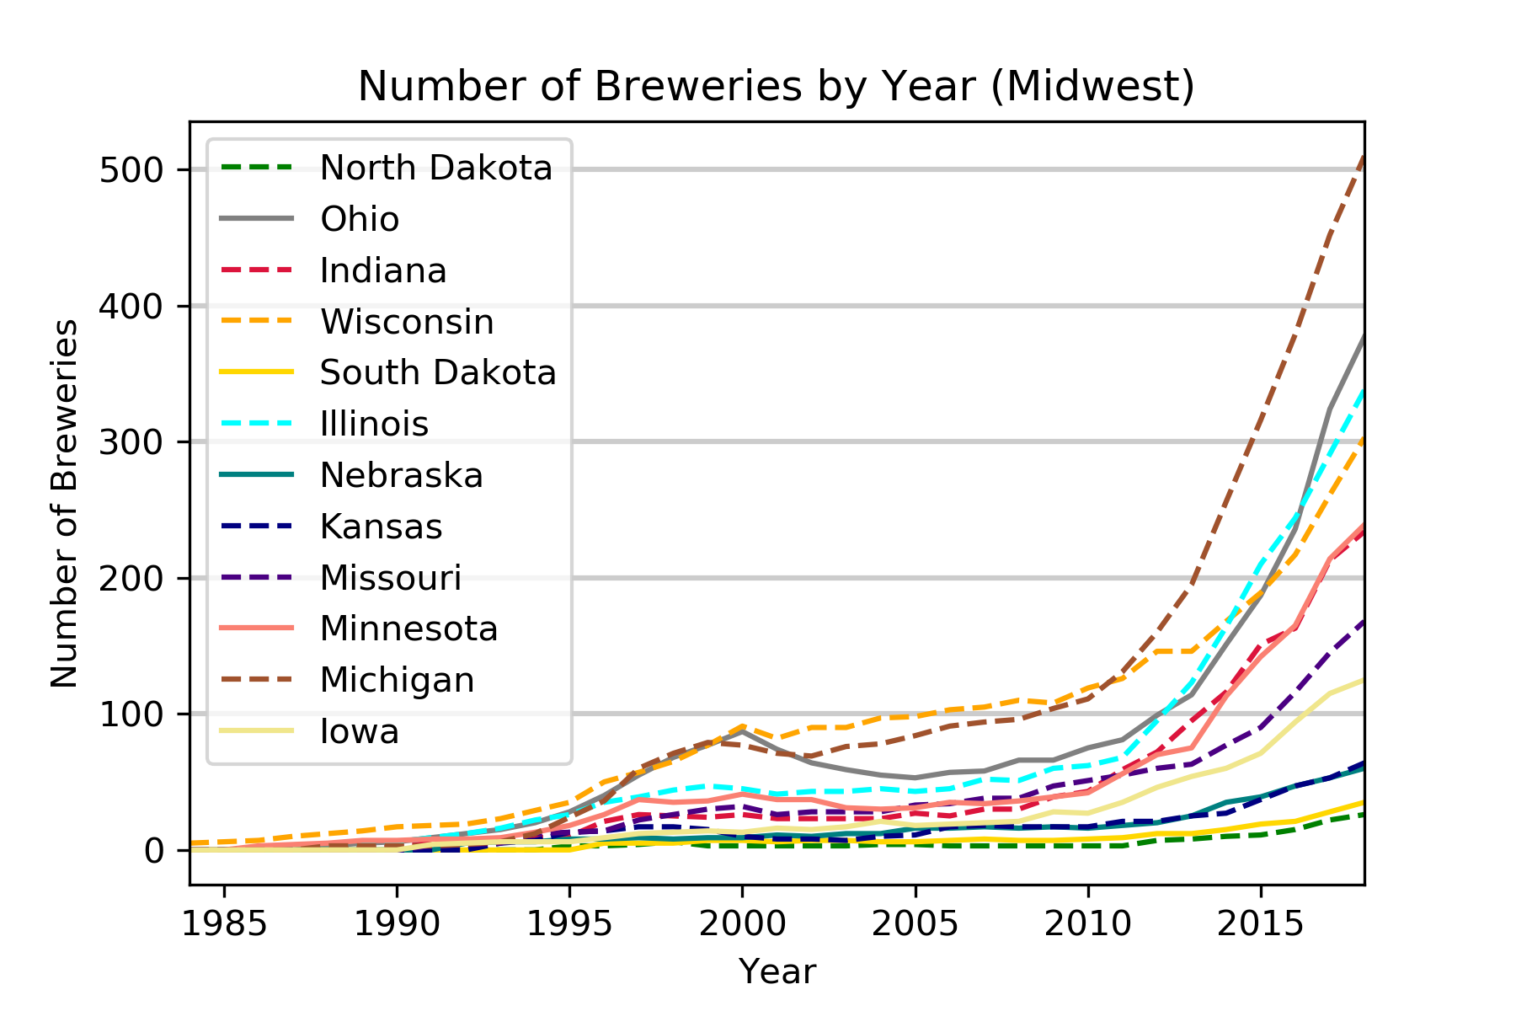
Growth in Number of Breweries by Region: MidW
MidW Leaders:
Michigan
Ohio
Illinois
Wisconsin
(Alcohol and Tobacco Tax and Trade Bureau)
Notes:
Number of breweries per year from 1985-2018 for states in the Midwest
Analysis: point out the leaders… early 2000’s was a rough time for brewers in OH

Slide 7
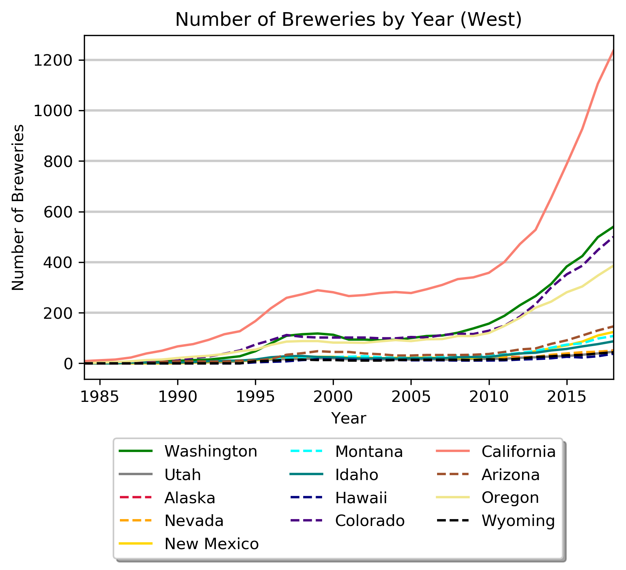
Growth in Number of Breweries by Region: West
West Leaders:
California
Washington
Colorado
(Alcohol and Tobacco Tax and Trade Bureau)
Notes:
Number of breweries per year from 1985-2018 for states in the West
Note that the y axis is higher here, it maxed out at 500 on the other graphs.
So, to see CA numbers relative to other states, I graphed the leaders from each region

Slide 8
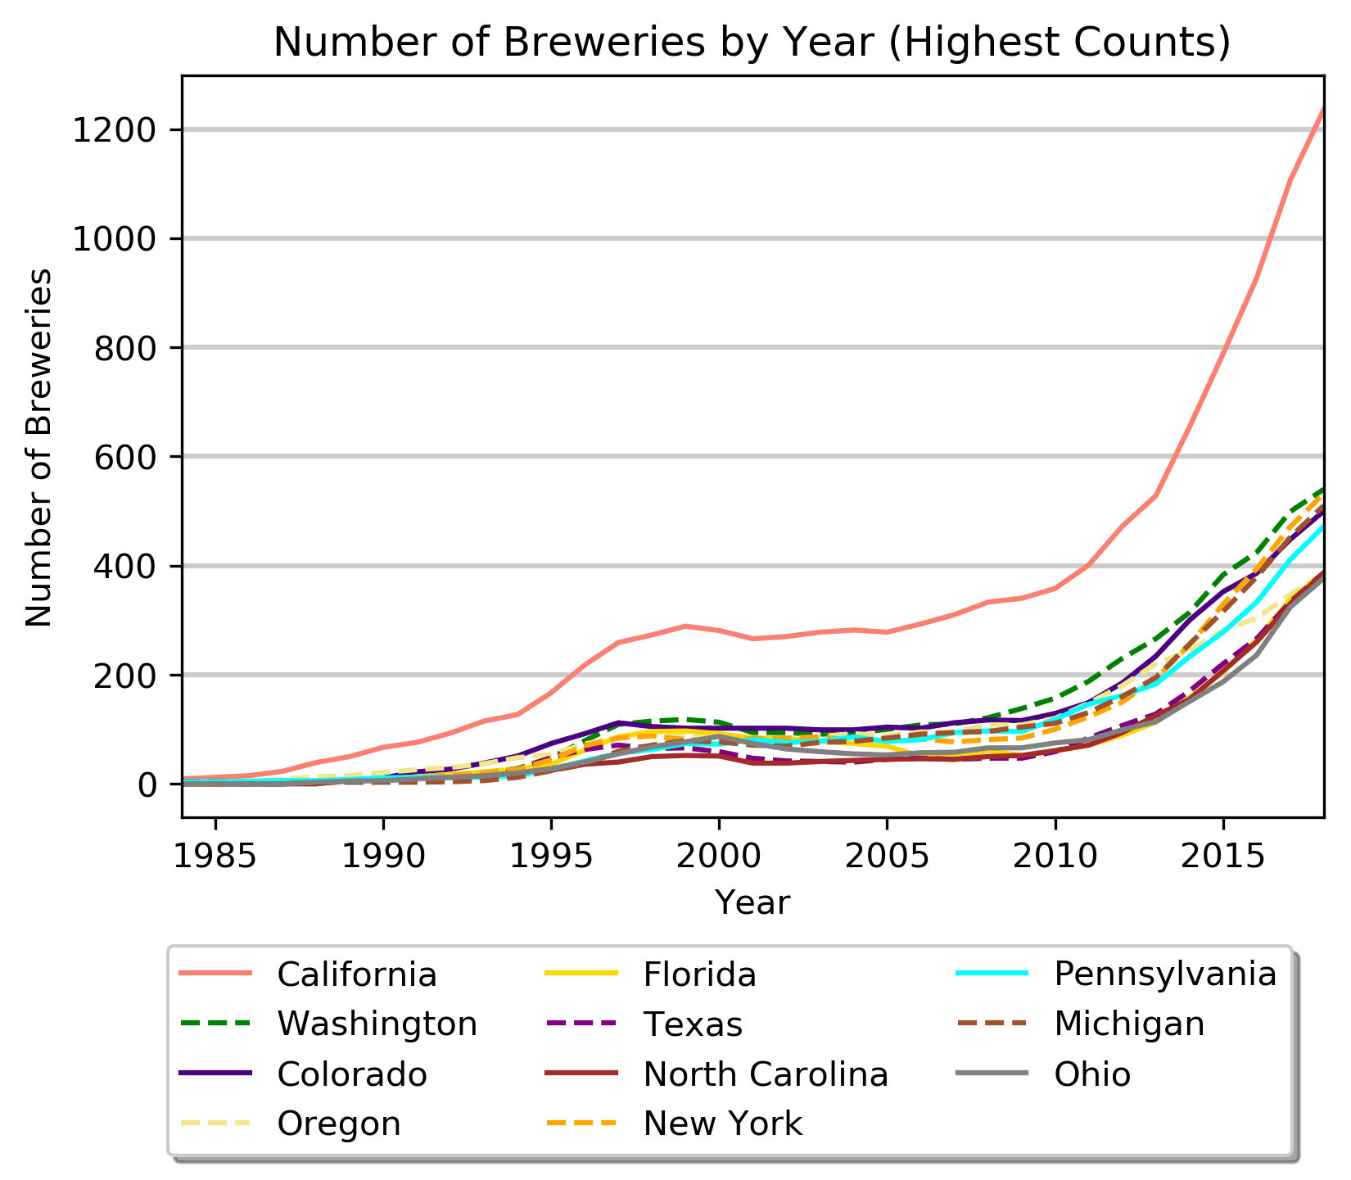
Growth in Number of Breweries (State Leaders Shown)
California
(Alcohol and Tobacco Tax and Trade Bureau)
Notes:
Number of breweries per year from 1985-2018: states with the most breweries shown
Analysis: CA has more than twice the breweries of the next state. Is this simply because of the larger population? Does CA beat these other states when we look at # of breweries per capita?
What does this look like on the map?

Slide 9
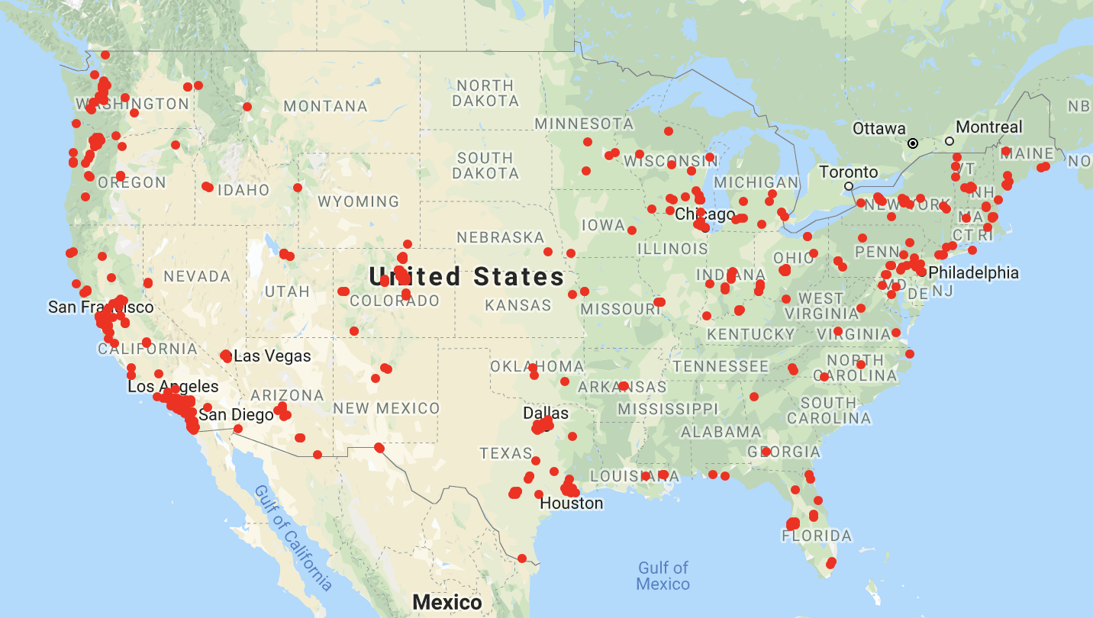
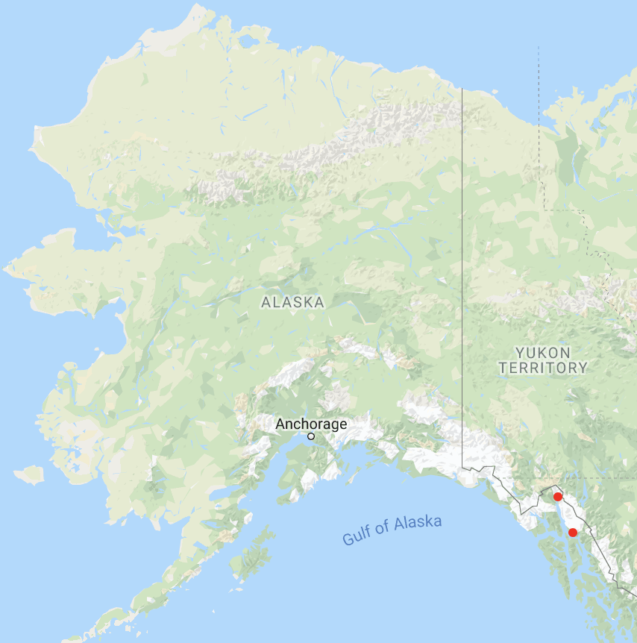
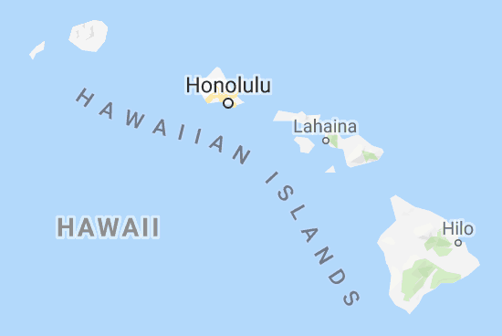
Breweries in the United States - 1990

Slide 10
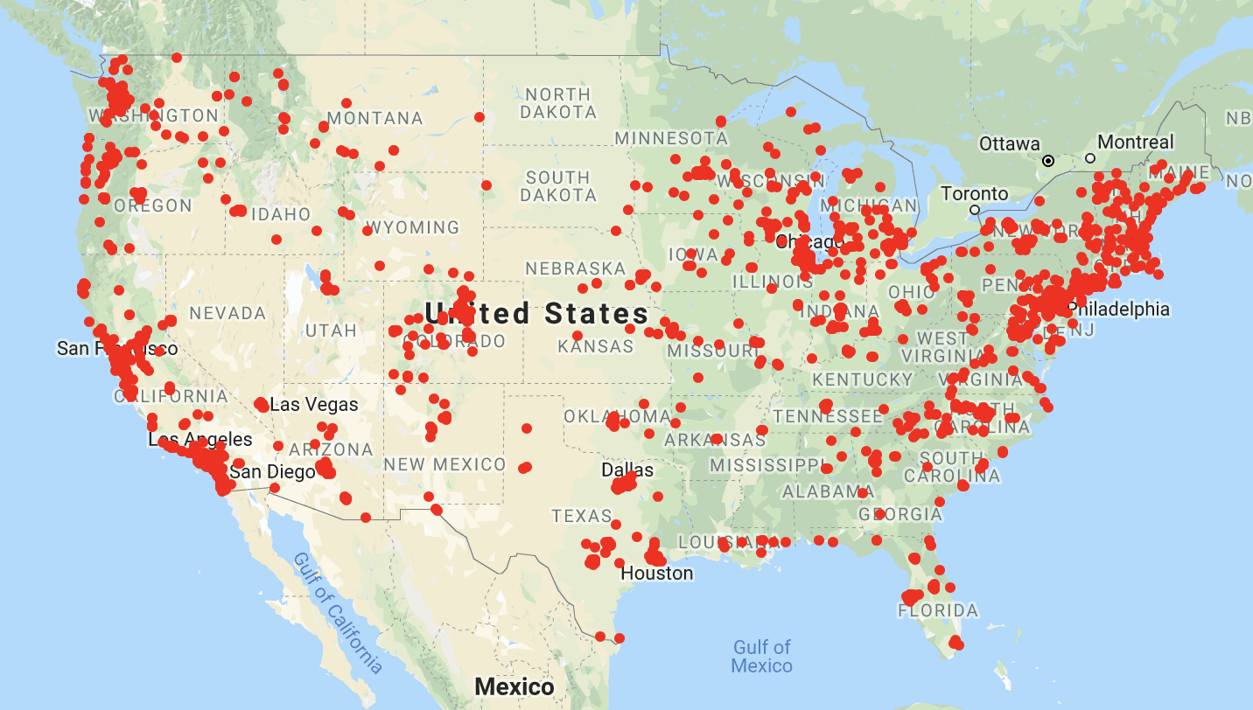
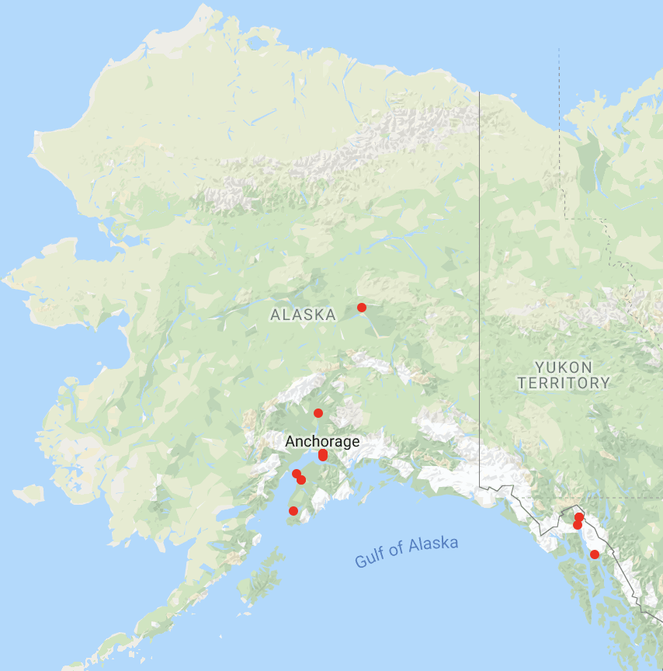
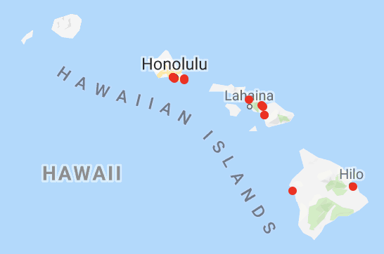
Breweries in the United States - 2009
#2 Washington (128)
#5 Wisconsin(91)
#4 Michigan(101)
#1 California(273)
#3 Colorado(105)
Notes:
Top 5 growth regions based on number of breweries
CA 273
WA 128
CO 105
MI 101
WI 91

Slide 11
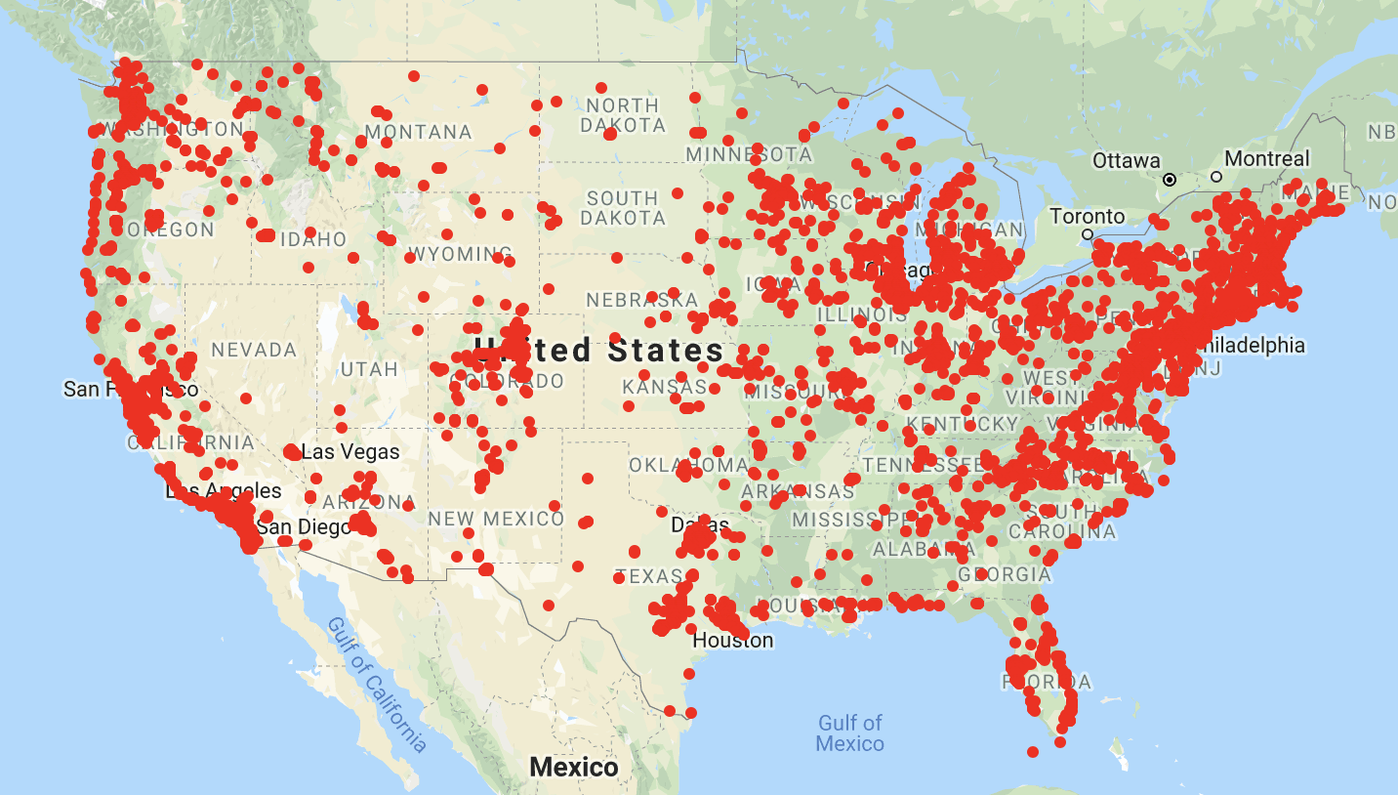

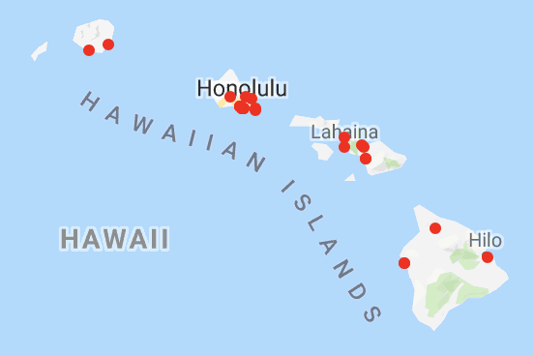
Breweries in the United States - Present
#4 Washington (402)
#3 Michigan (406)
#2 New York (448)
#1 California (896)
#5 Colorado (384)
Notes:
Top 5 growth regions based on number of breweries
CA - 896
NY - 448
MI - 406
WA - 402
CO - 384

Slide 12
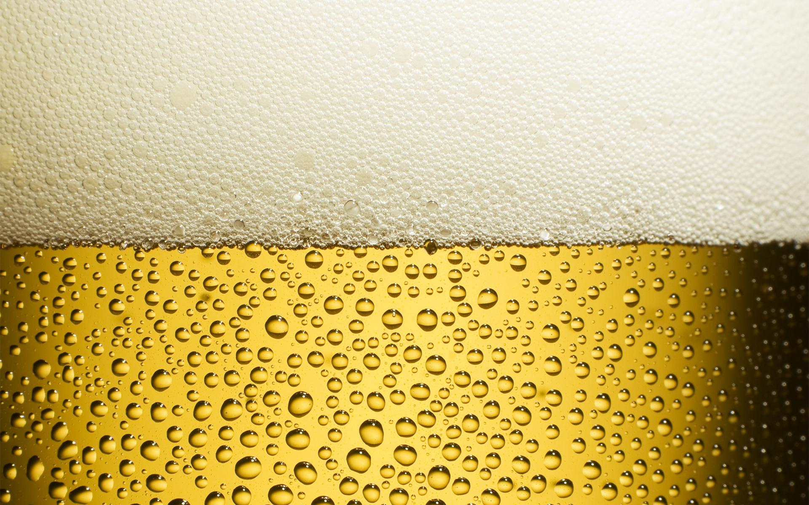
What characteristics explain this growth in breweries?

Slide 13
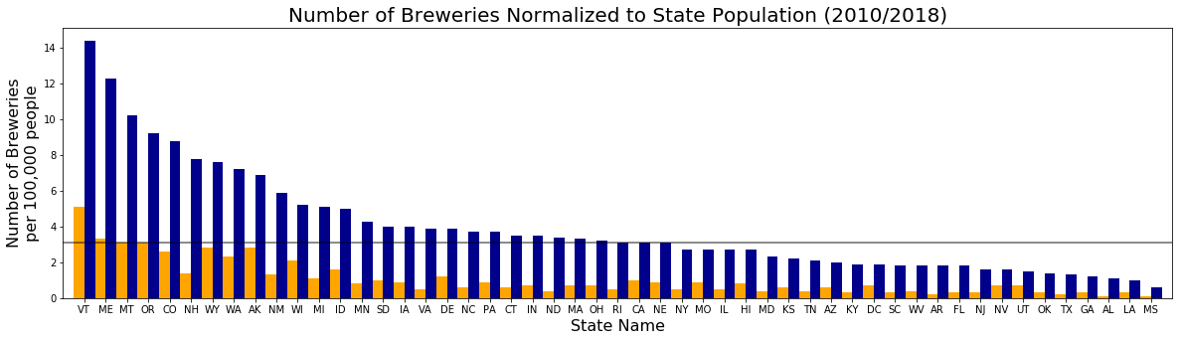
Number of Breweries Normalized by State Population
2010
2018
VT
VA
CA
(Alcohol and Tobacco Tax and Trade Bureau)
Notes:
Shown: Number of breweries per 100,000 residents in 2010 versus 2018: states are ordered from most dense to least
Analysis: All states have seen growth in the past 8 years; CA is not leading the way with breweries per capita, but is right at the national average (which is shown by the grey line); VT leads with way with roughly 14 breweries per 100,000 people, but that tells me that all 50 states still have a ways to go to make sure that all beer lovers are close to a brewery. VA is hanging out in the middle. And what is happening in the deep South? Lack of interest? Tough liquor laws? Not enough expendable income to support?
Transition: Does brewery number correlate with household income?
Formatting to do: Increase labels
Transition:

Slide 14
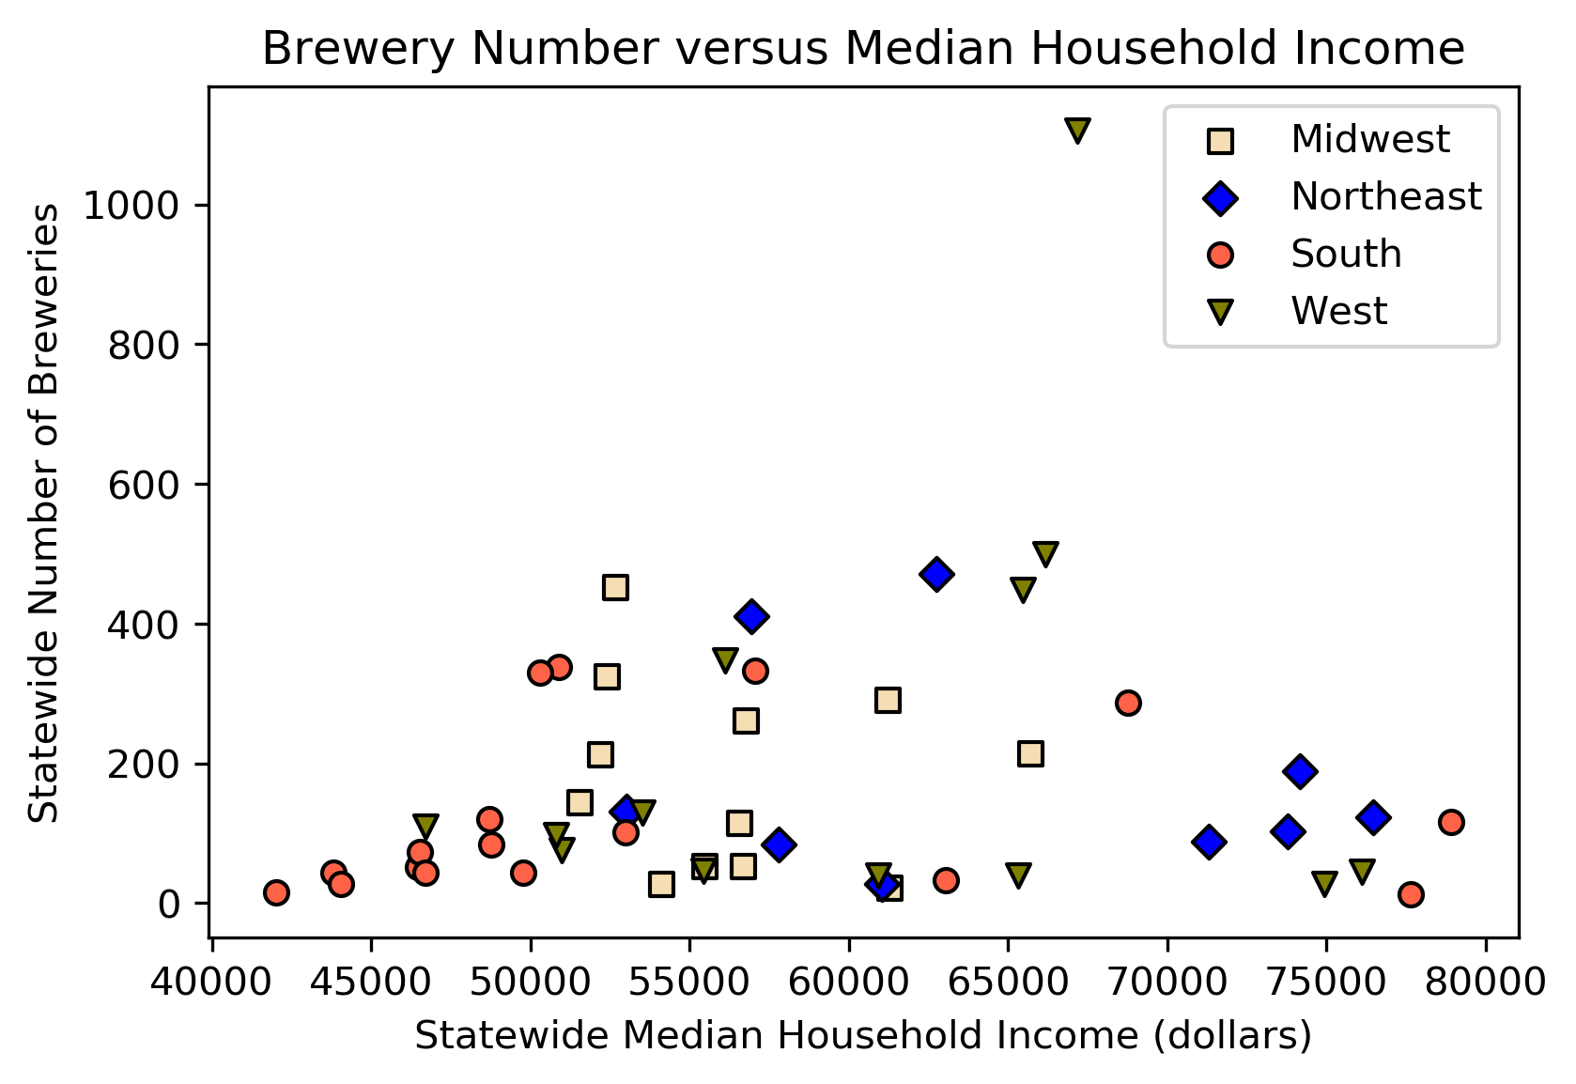
Number of Breweries Normalized to State Median Income
R² value = 0.018
p- value = 0.343
(Alcohol and Tobacco Tax and Trade Bureau)
Notes:
#0.01836392637756329
print ("p-value:", p_value) #0.3430521538685172
Statewide number of breweries plotted against median household income for 2017 data: each data point is a state; regions are color coded
Analysis: If there was a correlation, data would form some sort of diagonal line.
Regions show some clustering by income, but there isn’t a corresponding increase in breweries at the highest incomes
CA is the outlier and has more breweries than warranted for average household income; means one should be comfortable
about where you open a brewery in CA and look at this type of analysis by county
Cluster of southern states at left, showing the lowest incomes in the country and they do have less breweries
Cluster of NE states at right with high incomes, but still relatively low numbers of breweries here. Income suggests room for
growth, but can the population numbers and preference handle it?
One could do a lot more analyses like this to try and find correlating factors and predict states that have saturated or
competitive markets for that characteristic
Transition: What kinds of breweries are growing the most?
Do a best fit line and then Pearson correlation coefficient (1 tailed)

Slide 15
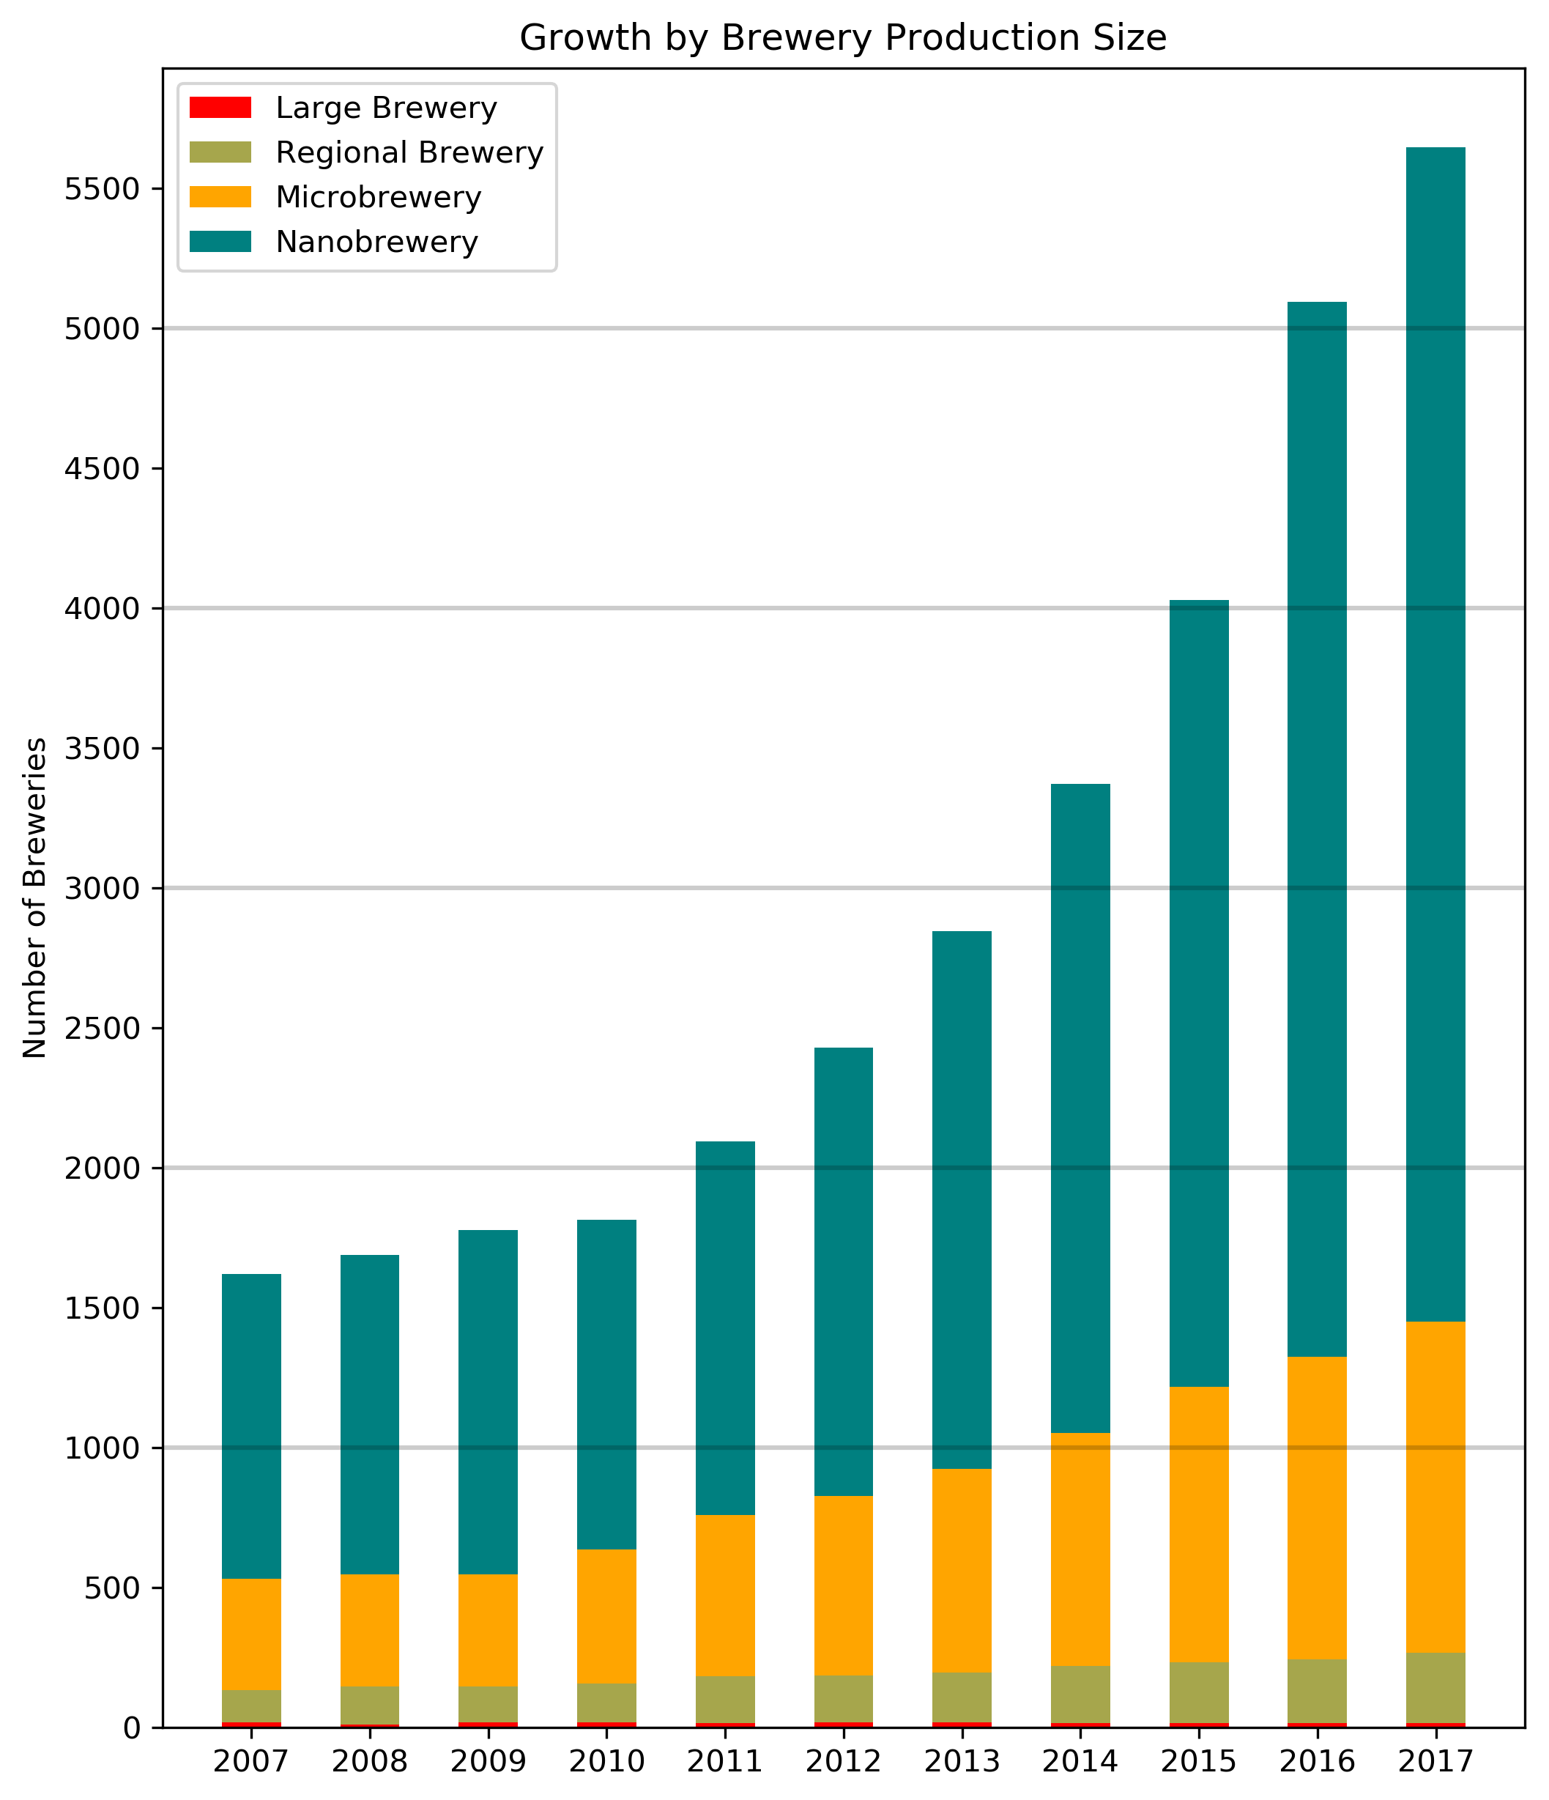

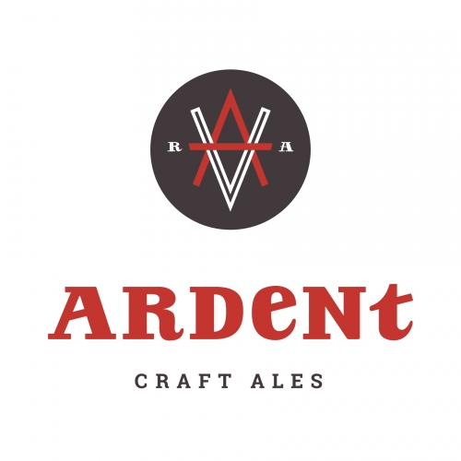

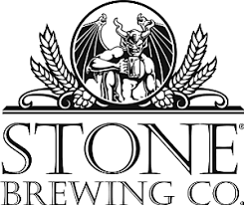
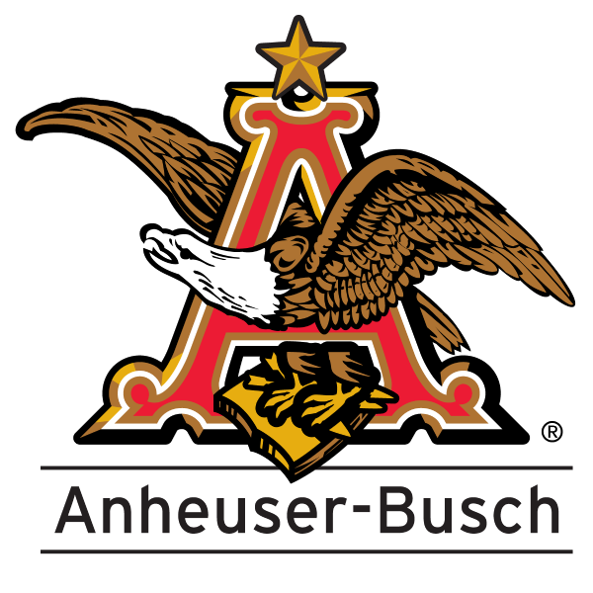
Growth in Brewery Number in US- binned by brewery type
Nanobrewery: up to 1,000 barrels (see notes)
Microbrewery: 1,001 to 15,000 barrels
Regional Brewery: 15,001 to 6 mill barrels
Large Brewery: more than 6 million barrels made per year
(Alcohol and Tobacco Tax and Trade Bureau)
Notes:
1st three designations are defined by US Brewers Association. Nanobrewery is a newer term. A new law in NH defines nanobreweries as less than 2000 barrels, but I can only separate 1000 barrels or less based on federal data. Local brands shown for comparison
Total breweries per year shown with stacked bars color coded by brewery type (based on production volume per year
There has been growth in regional, micro, and nano, but most at the lower levels.
Hard to see growth in each:
Large: 17 down to 15
Regional: 115% increase (more than doubled)
Micro: 198% increase (nearly 3 fold increase)
Nano: 286% increase (nearly a 4 fold increase)
Transition: But how does this growth impact the overall market share?
Formatting to do: Increase labels
Ardent (2000+ barrels), Hardywood (40K), Stone (345K),

Slide 16
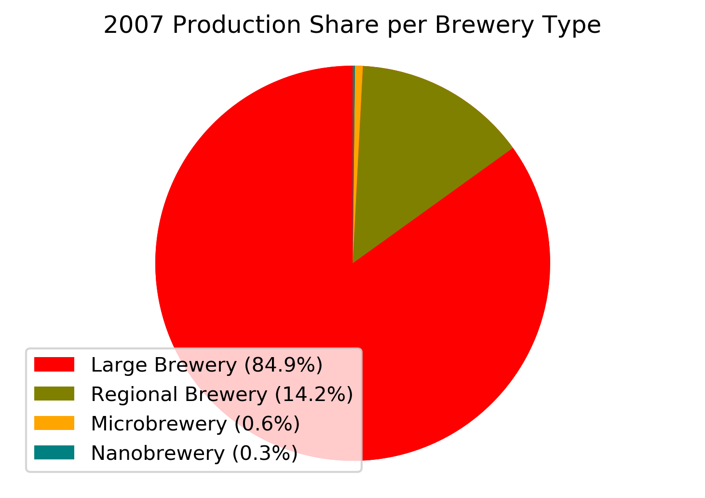
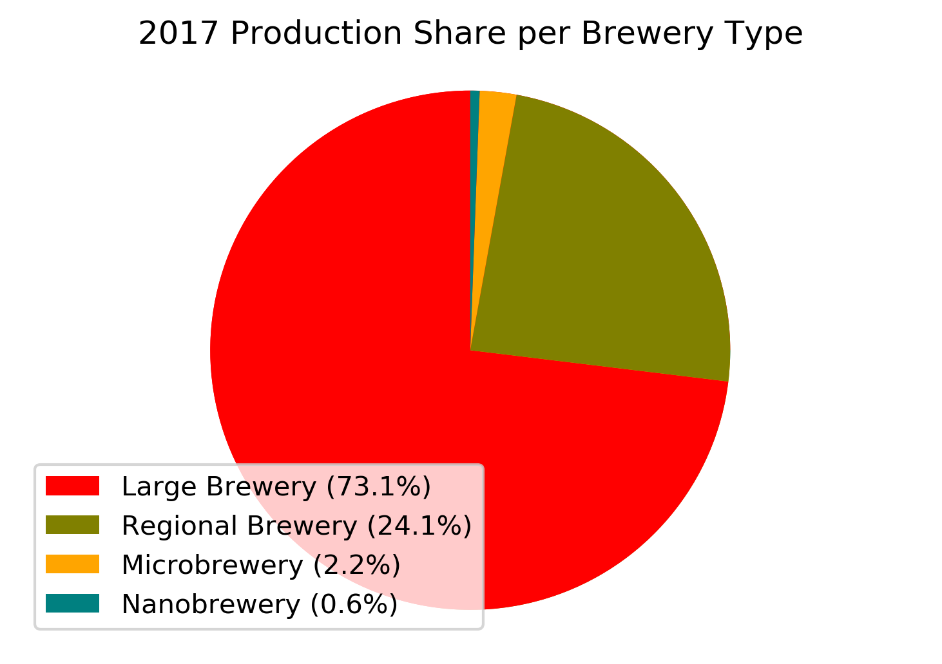
Which types of breweries contribute most to market share?
2007
2017
(Alcohol and Tobacco Tax and Trade Bureau)
Notes:
Shown: Production Market share by Brewery type in 2007 versus 2017
Analysis:
Large Breweries dominate the market, but their market share has dropped 12% from 2007. Why?
Less large breweries? Yes, there are 15 nor compared to 17 in 2007 (and average production is down 8000 barrels each)
And less beer is being produced overall (~320K less barrels); 1.675 mill in 2007 cf. 1.356 mill in 2017
So, losing market share = losing $ for the big beer companies
There has been growth in all other categories, but most of this market share has been taken by regional breweries (~10%) with microbreweries taking 1.6% and nanobreweries taking 0.3%.

Slide 17
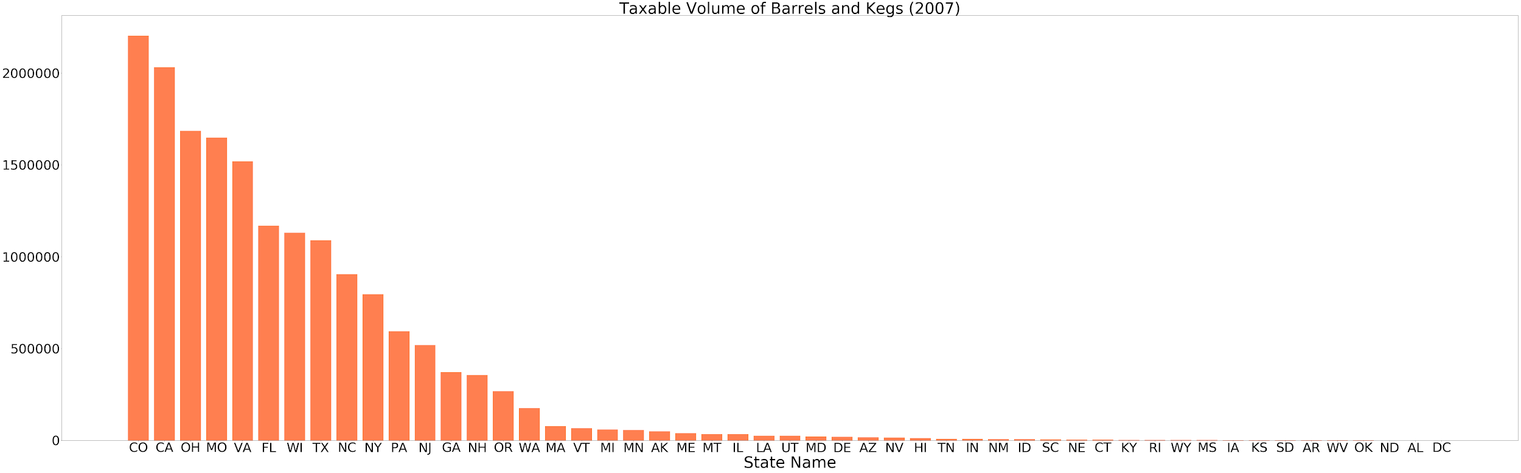
Barrels and kegs

Slide 18
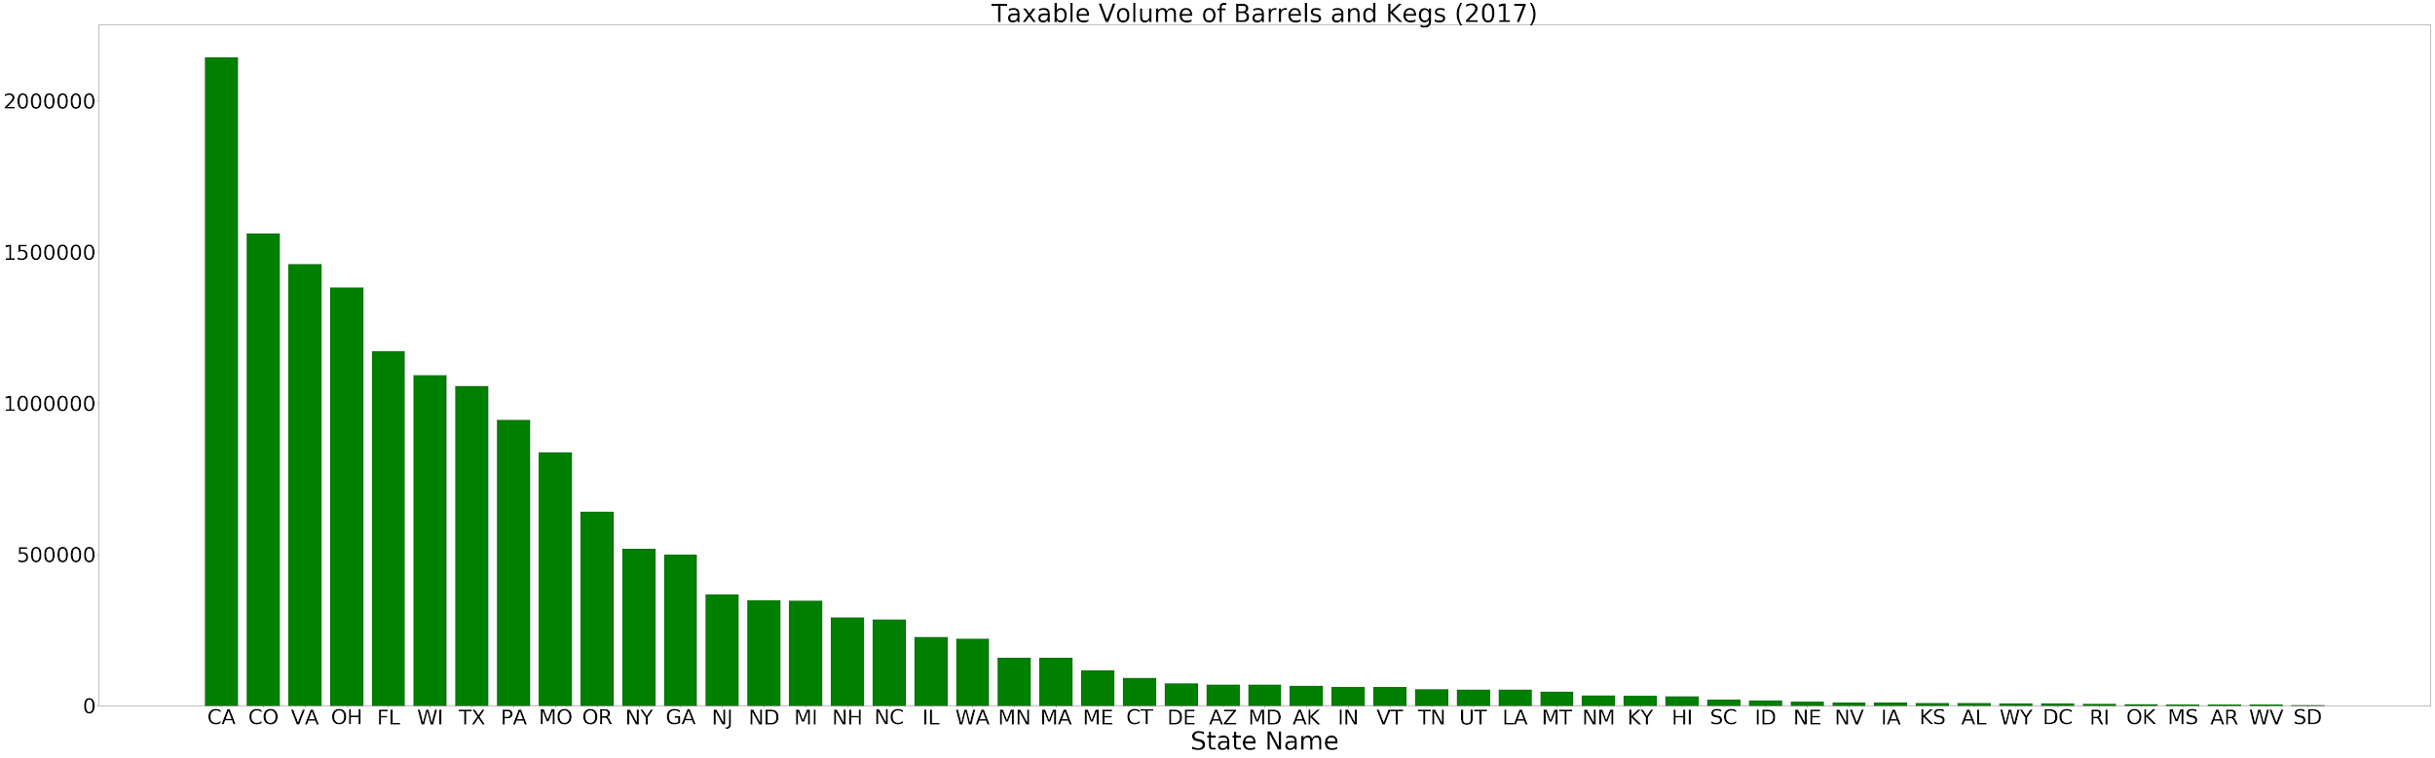
Barrels and kegs

Slide 19
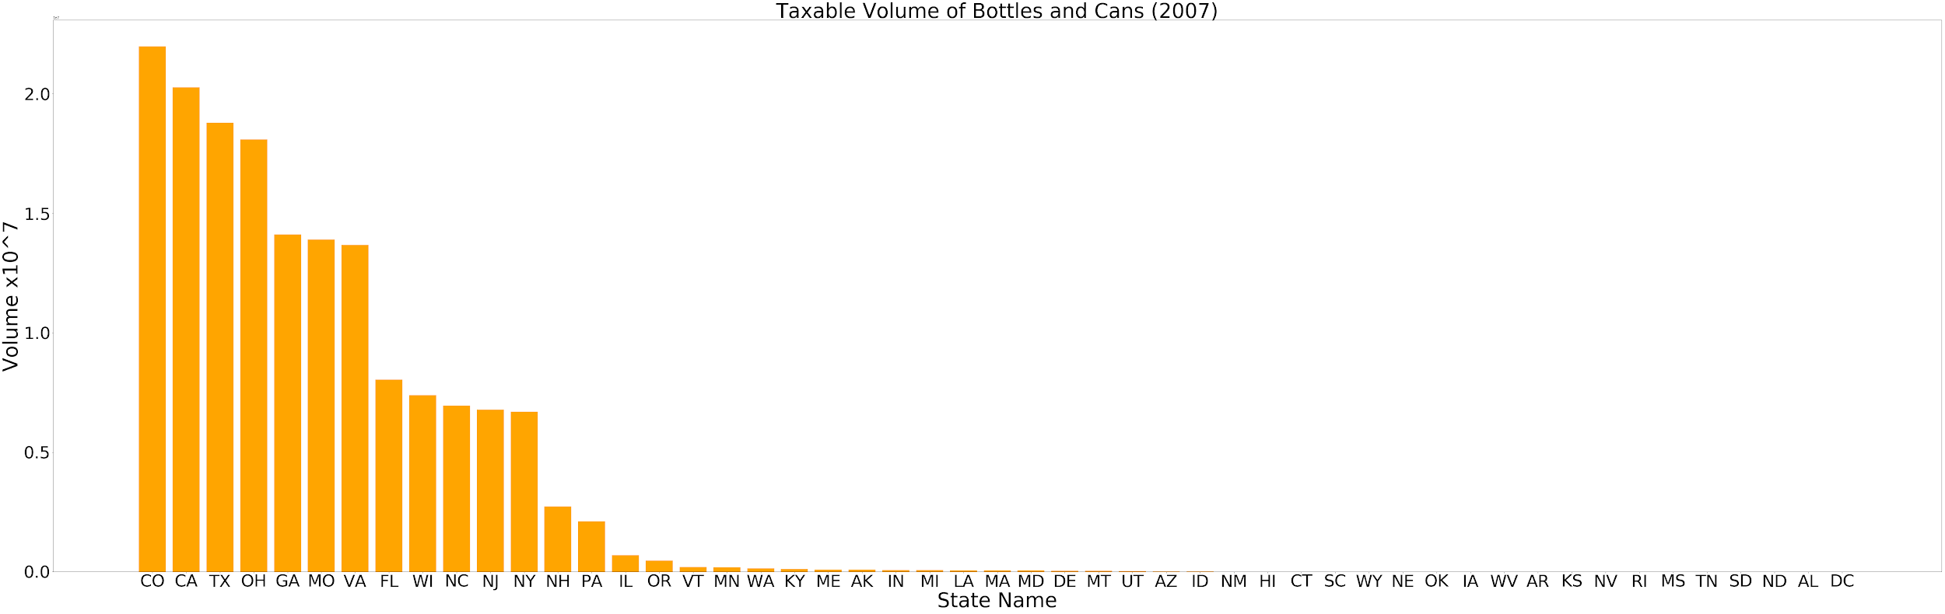
Total bottles/cans

Slide 20
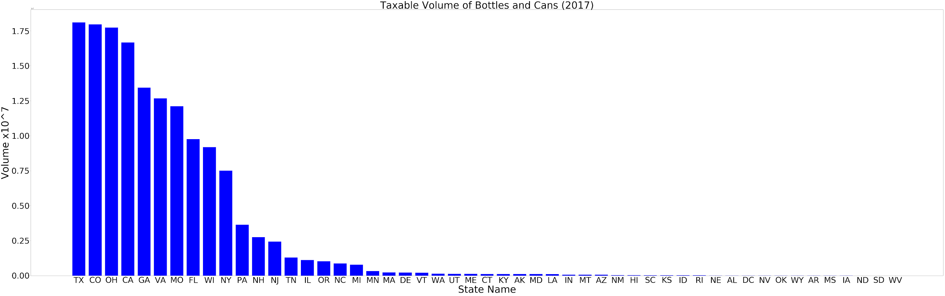
Total bottles/cans

Slide 21
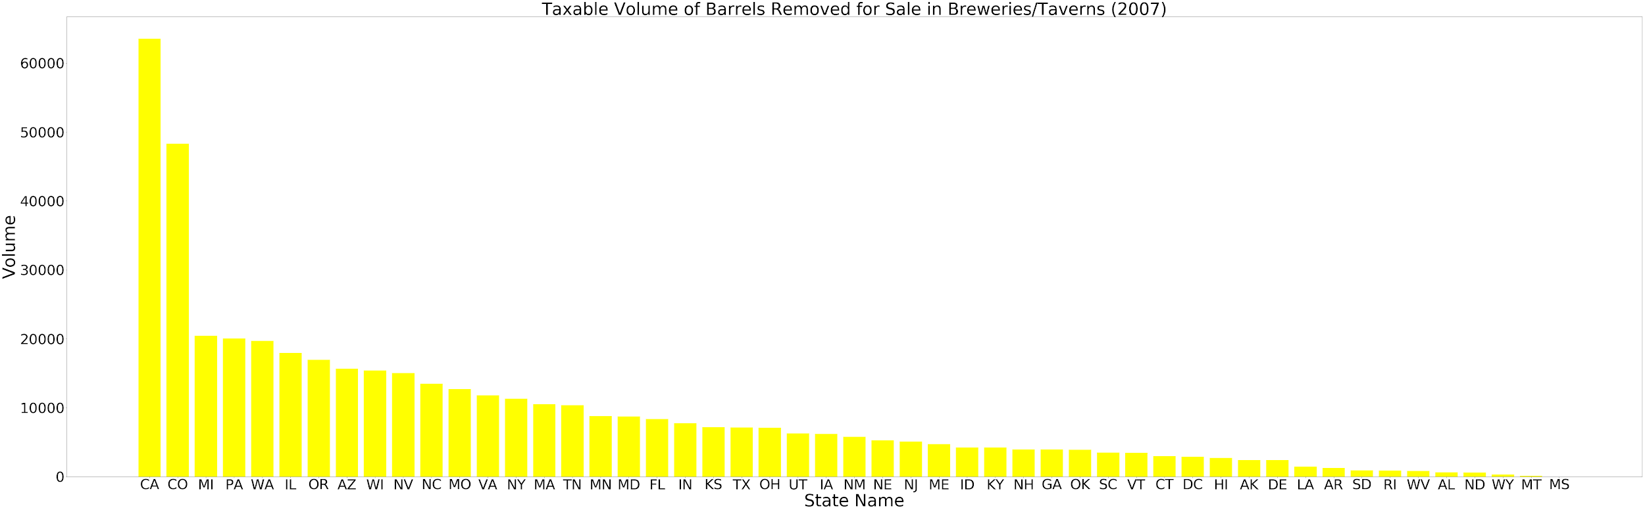
Barrels held for breweries and taverns

Slide 22
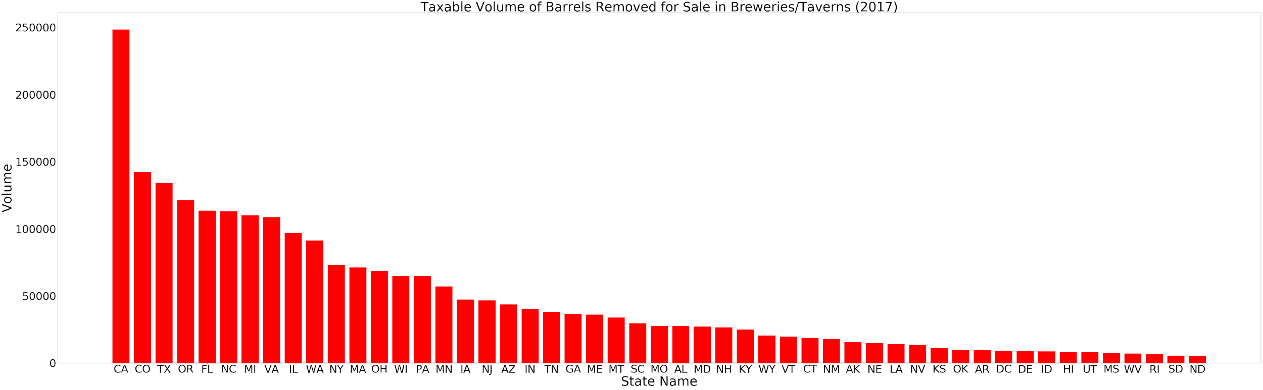
Barrels held for breweries and taverns

Slide 23
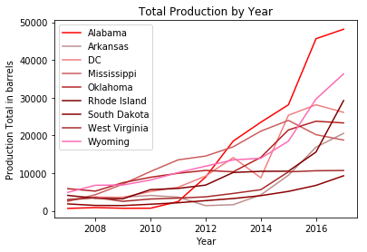
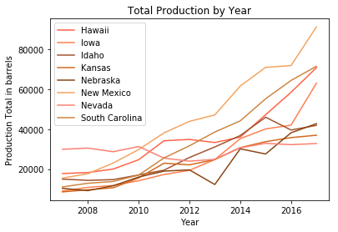
Smallest and mid range producer samples

Slide 24
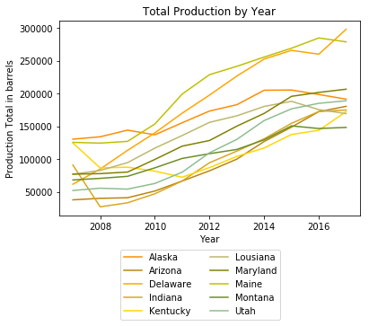
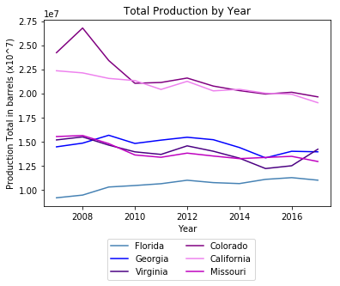
Upper tier and highest producer sample

Slide 25
Conclusions
Went from 2 dozen breweries in 1987, to nearly 2,000 in 1997, to more than 10,000 in 2017
Most states follow a similar trend line, both in number of breweries and production
This growth doesn’t have an equal distribution among states, and is usually in specific areas of the state
No correlation could be found between the number of breweries and the median income of the area
Nanobreweries are experiencing the highest growth, but it has a relatively small impact on the bigger producers
Would have liked to do a deeper dive if possible to see if there is a saturation point for a given area, or a correlation with some set of socioeconomic factors

Slide 26
Thanks! Any questions?

Slide 27

Slainte!

